Slide 1
Production Systems Control
Project
a.y. 2023 – 2024
Alberto Cantele
Prof. Luca Ferrarini

Slide 2


Shared resource with allocation request (1)
Two Users
TEACHER
STUDENT 1
STUDENT 2
Consider two students in a class-room “using” the single teacher, in the sense that each asks a question and is answered. When a student wants to pose a question, he calls the teacher’s attention by raising his hand and waits to be allowed to speak. Once the teacher gives his permission, the conversation continues until the student is satisfied.

Slide 3
Shared resource with allocation request (2)
Model of the student:
The states in which the student can be are five:
I: idle, student is just listening/waiting for an action.
R(1,2,3): requesting resources, student has raised up a hand and waits for teacher’s attention to ask one or more questions.
U: using resources, teacher has given attention to the student and student asks the questions.
The alphabet that moves the students from one state to another (events) is:
Rn1: student n asks for the attention of teacher 1 (uncontrollable).
Rn2: student n asks for the attention of teacher 2 (uncontrollable).
An: student n uses the resource, asks the questions to both the teachers.
REn: student n has no more questions and releases the teachers (uncontrollable).

Slide 4
Shared resource with allocation request (3)
Model of the Student:
St:
REn
Rn1
R1
Rn2
I
R3
An
U
Rn2
R2
Rn1
St1:
RE1
St2:
RE2
R11
R1
R12
R21
R1
R22
I
R3
A1
U
I
R3
A2
U
R12
R2
R11
R22
R2
R21

Slide 5
Shared resource with allocation request (4)
Model of the Teacher:
The states in which the teacher can be are three:
I: idle, teacher is just waiting for a student call
TnSm: teacher n to student m, teacher n is called and has given attention to student m
The alphabet is composed by the calling and the releasing from the two students
Tn:
R1n
R2n
TnS1
I
TnS2
RE1
RE2
Prof. Luca Ferrarini, Alberto Cantele 5

Slide 6
Shared resource with allocation request (5)
Model of the Teacher:
Tn:
R1n
R2n
TnS1
I
TnS2
RE1
RE2
T1
T2
R11
R21
R12
R22
T1S1
I
T1S2
T2S1
I
T2S2
RE1
RE2
RE1
RE2
Prof. Luca Ferrarini, Alberto Cantele 6

Slide 7
Shared resource with allocation request (6)
Model of the system with modular approach:
One possible way to model the Supremal Non-Blocking Supervisor from the point of view of the modular approach could be the following:
Define:
S1<=S01=St1||T1
S2<=S02=St2||T2
Compose S=S1||S2
After modelling Supervisor S, must be checked if it doesn’t block and is controllable. So must be verified:
Controllability
Non-blockingness
Prof. Luca Ferrarini, Alberto Cantele 7

Slide 8
Shared resource with allocation request (7)
S01: ∑_{S01}={ R11, R12, R21, A1, RE1}
I_T1S2
R21
I_I
R11
R1_T1S1
RE1
R12
R12
U_T1S1
R12
A1
R21
R11
R2_T1S2
R2_I
R3_T1S1
In this supervisor a deadlock occurs in paths I_I -> I_T1S2 -> R2_T1S2 and I_I -> R2_I -> R2_T1S2.
To remove it, it is sufficient just to mark the initial state as Marked state and trim the automata
Prof. Luca Ferrarini, Alberto Cantele 8

Slide 9
Shared resource with allocation request (8)
S02: ∑_{S02}={ R21, R22, R12, A1, A2, RE2}
R22
I_I
R12
R2_T2S2
I_T2S1
RE2
R21
U_T2S2
R21
R21
A2
R22
R12
R3_T2S2
R1_I
R1_T2S1
In this supervisor a deadlock occurs in paths I_I -> I_T2S1 -> R1_T2S1 and I_I -> R1_I -> R1_T2S1.
To remove it, it is sufficient just to mark the initial state as Marked state and trim the automata
Prof. Luca Ferrarini, Alberto Cantele 9

Slide 10
Shared resource with allocation request (9)
S1:
S2:
R11
R22
I_I
I_I
R1_T1S1
R2_T2S2
RE1
RE2
R12
U_T1S1
R12
R21
U_T2S2
R21
A1
A2
R11
R22
R2_I
R3_T1S1
R3_T2S2
R1_I
Once trimmed, the two supervisors must be composed with synchronous composition to define the Supremal Non-Blocking Supervisor.

Slide 11
Shared resource with allocation request (10)
SPECIFICATIONS:
Sp1: the two users should not use the resource simultaneously and each user should always be able to repeat its request-use-release cycle;
Sp2: the user that first requests the resource should also be first granted access to it;
All the specifications are in practice what teacher should do, so modelling the teacher correctly should guarantee a good starting.
As S1 and S2 already fulfill the specifications and there aren’t any deadlocks:
S1= S01=St1||T1
S2= S02=St2||T2
Always using as notation Q(St1)_Q(St2)_Q(T1)_Q(T2)

Slide 12
Shared resource with allocation request (11)
Model of the Supremal supervisor: S=S1||S2
∑_{S}={ R11, R12, R21, R22, A1, A2, RE1, RE2}
R3_I_T1S1_T2S1
R12
R1_I_T1S1_I
R22
R1_R2_T1S1_T2S2
A1
R11
U_I_T1S1_T2S1
R11
R11
RE1
R2_I_I_T2S1
R12
I_I_I_I
R22
I_R2_I_T2S2
RE2
R21
R21
I_U_T1S2_T2S2
R21
A2
R2_R1_T1S2_T2S1
R12
I_R1 _T1S2_I
R22
I_R3_T1S2_T2S2
Deadlocks occur, as before mark the initial state as Marked State and Trim

Slide 13
Shared resource with allocation request (12)
Model of the Supremal supervisor: S=S1||S2
∑_{S}={ R11, R12, R21, R22, A1, A2, RE1, RE2}
R3_I_T1S1_T2S1
R12
R1_I_T1S1_I
A1
R11
U_I_T1S1_T2S1
R11
RE1
R2_I_I_T2S1
R12
I_I_I_I
R22
I_R2_I_T2S2
RE2
R21
I_U_T1S2_T2S2
R21
A2
I_R1 _T1S2_I
R22
I_R3_T1S2_T2S2
Now controllability and Non-blockingness must be verified

Slide 14
Shared resource with allocation request (13)
Controllability:
Starting from the general formula for controllability:
L(S)𝛴𝜔 ∩ L(P) ⊆ L(S)
Substituting S=S1||S2 and P=P1||P2:
L(S1||S2) 𝛴𝜔 ∩L(P1||P2) ⊆ L(S1||S2)
Applying the property L(a||b)=L(a) ∩ L(b):
[L(S1) ∩ L(S2)] 𝛴𝜔 ∩ L(P1) ∩ L(P2) ⊆ L(S1) ∩ L(S2)
Applying the associativity property:
L(S1) 𝛴𝜔 ∩ L(S2) 𝛴𝜔 ∩ L(P1) ∩ L(P2) ⊆ L(S1) ∩ L(S2)
As intersections, the solutions for S1 and S1 can be represented as a system:
L(S1) 𝛴𝜔 ∩L(P1) ⊆ L(S1)
L(S2) 𝛴𝜔 ∩L(P2) ⊆ L(S2)

Slide 15
Shared resource with allocation request (14)
Non-blockingness: First both the automata must be extended to the same alphabet
S1:
S2:
R22,R21,A2,RE2
R11,R12,A1,RE1
R11,R12,A1,RE1
R22,R21,A2,RE2
R11
R22
I_I
I_I
R1_T1S1
R2_T2S2
RE1
R22,R21,A2,RE2
R11,R12,A1,RE1
RE2
R12
U_T1S1
R12
R21
U_T2S2
R21
A1
A2
R11
R22
R2_I
R3_T1S1
R3_T2S2
R1_I
R22,R21,A2,RE2
R22,R21,A2,RE2
R11,R12,A1,RE1
R11,R12,A1,RE1

Slide 16
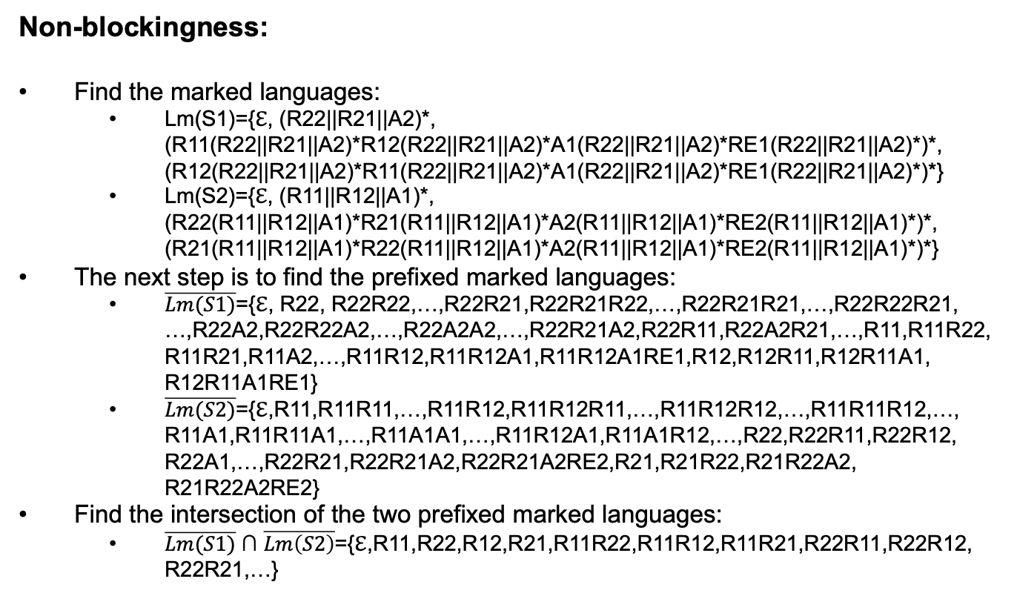
Shared resource with allocation request (15)
Non-blockingness:
Find the marked languages:
Lm(S1)={ℇ, (R22||R21||A2)*, (R11(R22||R21||A2)*R12(R22||R21||A2)*A1(R22||R21||A2)*RE1(R22||R21||A2)*)*, (R12(R22||R21||A2)*R11(R22||R21||A2)*A1(R22||R21||A2)*RE1(R22||R21||A2)*)*}
Lm(S2)={ℇ, (R11||R12||A1)*, (R22(R11||R12||A1)*R21(R11||R12||A1)*A2(R11||R12||A1)*RE2(R11||R12||A1)*)*, (R21(R11||R12||A1)*R22(R11||R12||A1)*A2(R11||R12||A1)*RE2(R11||R12||A1)*)*}
The next step is to find the prefixed marked languages:
$\overline{Lm(S1)}$={ℇ, R22, R22R22,…,R22R21,R22R21R22,…,R22R21R21,…,R22R22R21, …,R22A2,R22R22A2,…,R22A2A2,…,R22R21A2,R22R11,R22A2R21,…,R11,R11R22, R11R21,R11A2,…,R11R12,R11R12A1,R11R12A1RE1,R12,R12R11,R12R11A1, R12R11A1RE1}
$\overline{Lm(S2)}$={ℇ,R11,R11R11,…,R11R12,R11R12R11,…,R11R12R12,…,R11R11R12,…, R11A1,R11R11A1,…,R11A1A1,…,R11R12A1,R11A1R12,…,R22,R22R11,R22R12, R22A1,…,R22R21,R22R21A2,R22R21A2RE2,R21,R21R22,R21R22A2, R21R22A2RE2}
Find the intersection of the two prefixed marked languages:
$\overline{Lm(S1)}$ ∩ $\overline{Lm\left(S2\right)}$={ℇ,R11,R22,R12,R21,R11R22,R11R12,R11R21,R22R11,R22R12, R22R21,…}

Slide 17
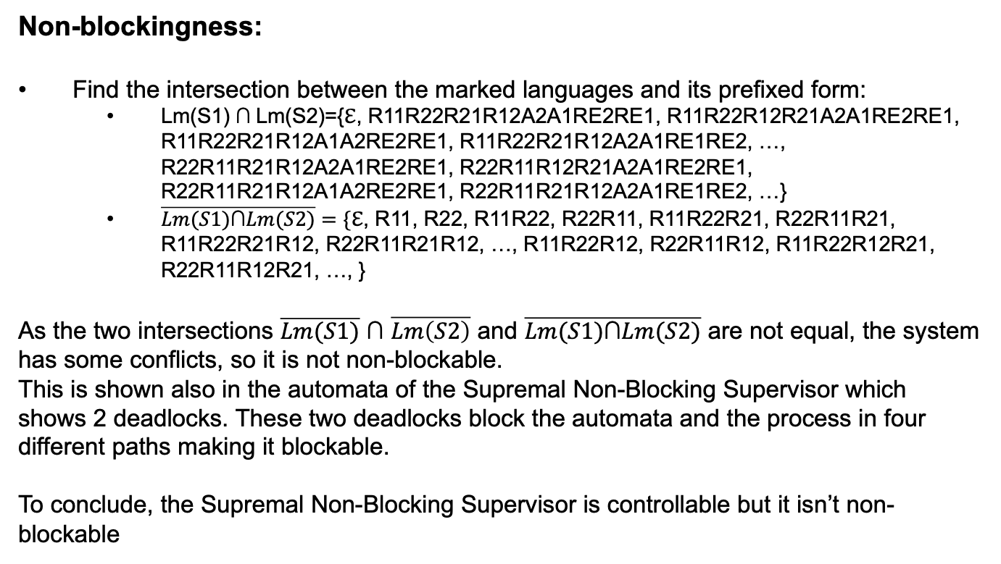
Shared resource with allocation request (16)
Non-blockingness:
Find the intersection between the marked languages and its prefixed form:
Lm(S1) $\text{∩}$Lm(S2)={ℇ, R11R22R21R12A2A1RE2RE1, R11R22R12R21A2A1RE2RE1, R11R22R21R12A1A2RE2RE1, R11R22R21R12A2A1RE1RE2, …, R22R11R21R12A2A1RE2RE1, R22R11R12R21A2A1RE2RE1, R22R11R21R12A1A2RE2RE1, R22R11R21R12A2A1RE1RE2, …}
$\overline{Lm(S1)\text{∩}Lm(S2)}=\{$ℇ, R11, R22, R11R22, R22R11, R11R22R21, R22R11R21, R11R22R21R12, R22R11R21R12, …, R11R22R12, R22R11R12, R11R22R12R21, R22R11R12R21, …, }
As the two intersections $\overline{Lm(S1)}$ ∩ $\overline{Lm\left(S2\right)}$ and $\overline{Lm(S1)\text{∩}Lm(S2)}$ are not equal, the system has some conflicts, so it is not non-blockable.
This is shown also in the automata of the Supremal Non-Blocking Supervisor which shows 2 deadlocks. These two deadlocks block the automata and the process in four different paths making it blockable.
To conclude, the Supremal Non-Blocking Supervisor is controllable but it isn’t non-blockable

